Slide 1



PondNet
Surveying for macroinvertebrates
Adapted from a presentation created by Martin Hammond

Slide 2

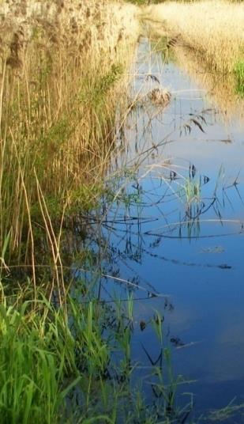
Aquatic macroinvertebrates in ponds

Slide 3
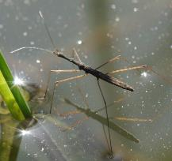
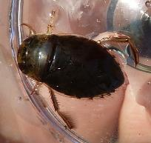
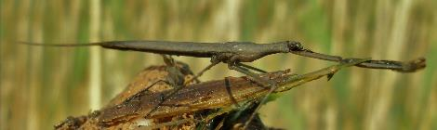
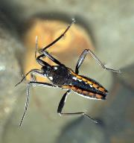
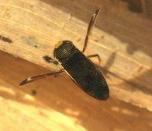
Water bugs
Relatively easy to identify
Useful indicators of structural diversity
Ecologically important
Species respond to vegetation structure, successional stage, water pH, predation pressure
Adults mostly in spring and autumn

Slide 4

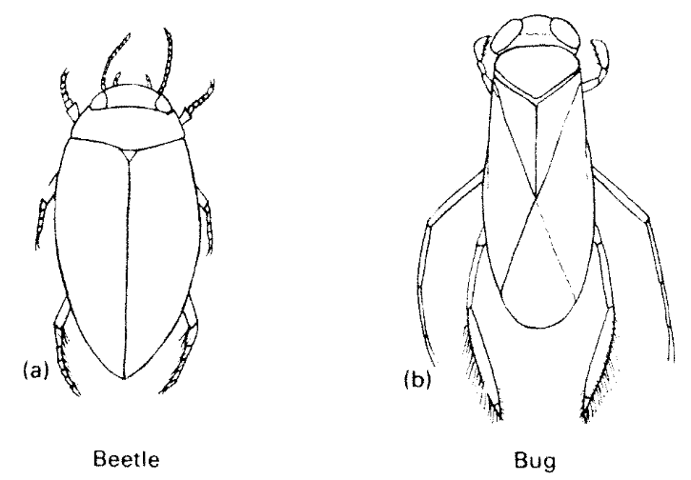
Differences between beetles and bugs

Slide 5
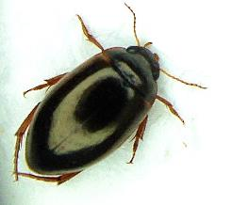
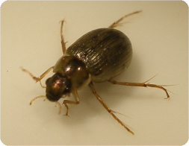
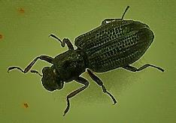
Water beetles
By far the most speciose group which can be sampled with a pond net
Ecology and distribution of species well known
Adults can be sampled almost throughout year
Distinct assemblages (e.g. acidic peat, fenland drains, pioneers)
Some species indicative of ancient wetlands
Species level ID tricky for some genera

Slide 6
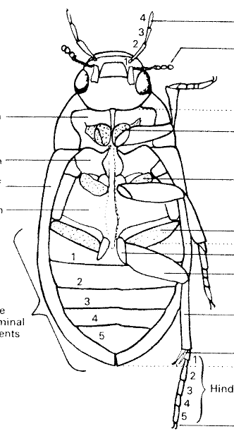
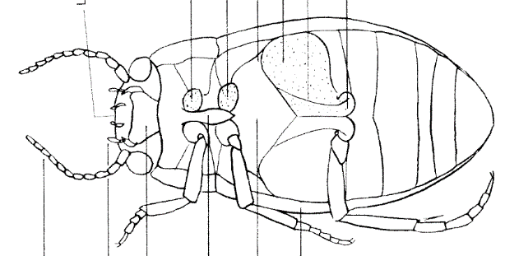
HIND COXAE
Dytiscidae
Hydrophilidae

Slide 7
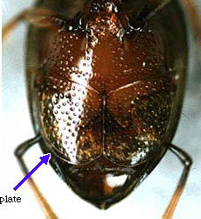
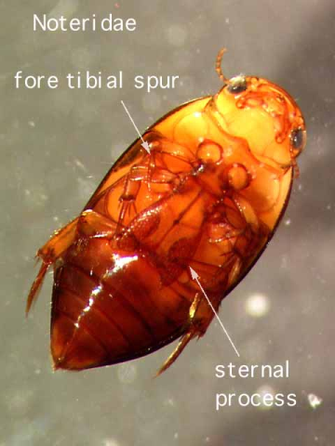

Haliplidae
Noteridae

Slide 8

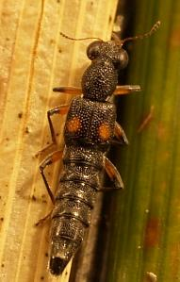
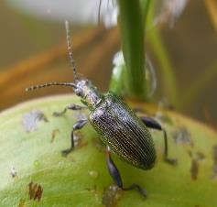
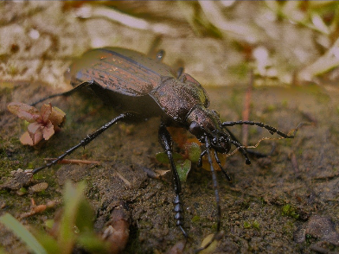
Other wetland Coleoptera
No strict definition of water beetles
Ground beetles, rove beetles etc. associated with water margins outnumber fully aquatic species
Reed beetles important indicators of high quality standing waters but many species declining internationally

Slide 9
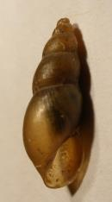
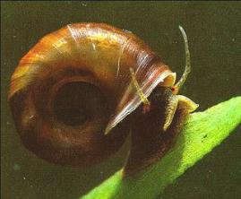
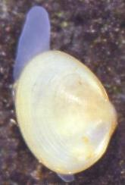
Aquatic molluscs
Easy to moderately difficult to ID to species (smaller ramshorns tricky)
Pea mussels often excluded – very difficult to ID
Low diversity in most ponds and stagnant drains, higher in base-rich waters with moderate flow and varied vegetation structure
Overgrown, seasonal, peaty pools & ditches may be important for Mud Snail

Slide 10

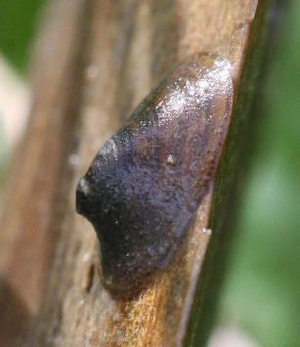
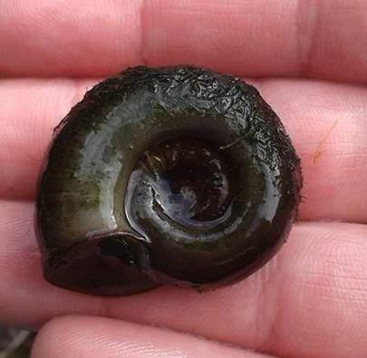
Snails - a brief overview
Freshwater limpet - Acroloxidae
Ram’s-horn snails - Planorbidae

Slide 11
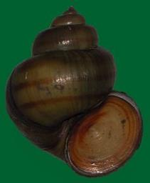
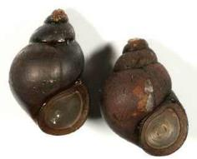
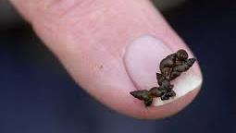
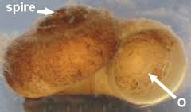
Snails with an operculum
Faucet snails – Bithyniidae
17mm
River snails – Viviparidae
30mm
Valve snails – Valvatidae
15mm
Jenkin’s spire snail – Hydrobiidae
6mm

Slide 12
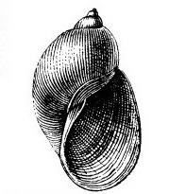
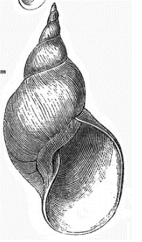
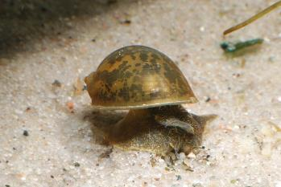
What else could it be?
- spire snails without an operculum
FAMILY
LYMNAEIDAE
Radix balthica
Very large aperture
12-20mm
Lymnaea stagnalis
Very large + pointed spire
35-50mm

Slide 13

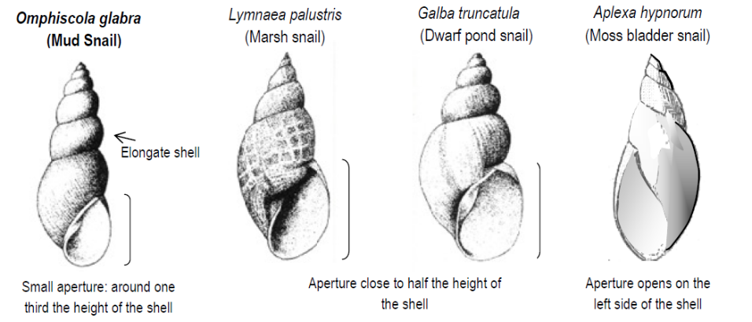
http://www.conchsoc.org
What else could it be?
- spire snails without an operculum
14-25mm
19-24mm
8-12mm
9-15mm

Slide 14
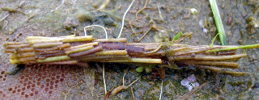
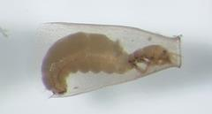
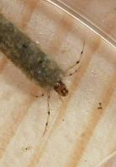
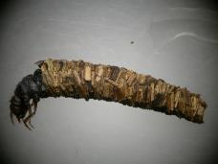
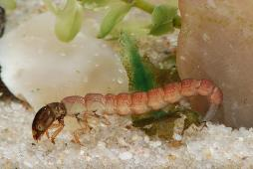
Caddis flies
Can be frequent in still water: a large component of the pond fauna overall though there may be few species in individual ponds
Scarce in mud/silt: prefer firm substrate or well-structured habitat (stony streams, leaf litter pools, submerged weed beds)
Some taxa very small, cryptic and seasonal
The widespread Limnephilidae are time consuming to ID to species
Notes:
198 species

Slide 15
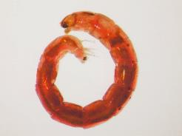
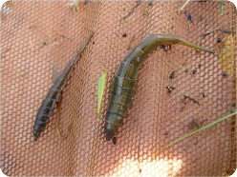
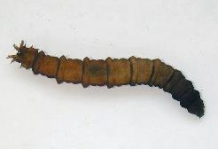
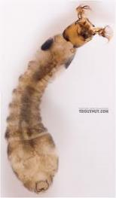
True Flies
Aquatic fly larvae are widespread, abundant and of huge ecological importance
Only a few taxa amenable to sampling with a pond net
Soldierflies (Stratiomyidae) are useful indicators of high quality ponds & ditches and have distinctive larvae, identifiable to species
Other Diptera such as snail-killing flies (Sciomyzidae) also very characteristic of ponds and ditches.

Slide 16
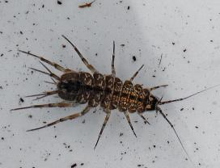
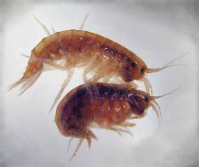
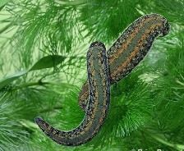
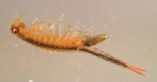
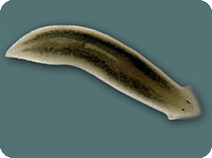
Other groups
Leeches fairly easy to ID (live!) but only a few common species.
Medicinal Leech stronghold in a few ponds in the New Forest.
Flatworms: need to be collected live.
‘Macro’ crustacea (hoglice, amphipod shrimps) – very few common species, more in brackish water.

Slide 17
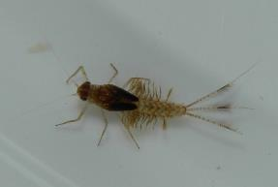
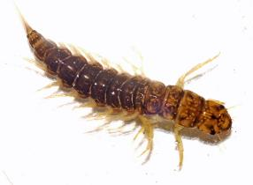
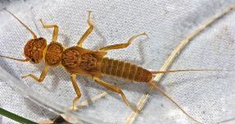
Other groups
Mayflies: usually only Pond Olive, occasionally Caenis species. Others in lakes.
Alderflies: one common species and counts in two PSYM metrics!
Stoneflies: infrequent and usually only one or two species e.g. Nemoura cinerea. More in wave-washed lakes.

Slide 18

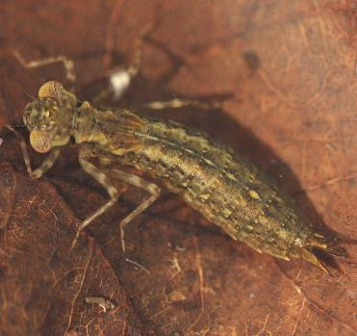
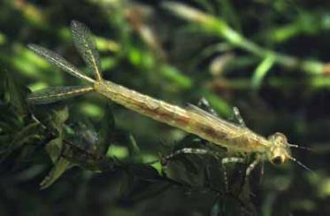
Other groups
Dragonflies and damselflies: very popular, well-recorded group.
Adults often very mobile, records of larvae or exuviae needed to prove breeding.
Good ecological indicators.
Some larvae present all year but sampling in early summer most effective: annual species only present as eggs or tiny larvae in late summer.

Slide 19
Now your turn . . .

