Slide 1
People, Ponds and Water
What’s happening to the quality of our best ponds?
A re-survey of National Pond Survey sites after 24 years
Penny Williams Feb 2018
Citation: Williams, P. (2018) What’s happening to the quality of our best ponds? A re-survey of National Pond Survey sites after 24 years. Freshwater Habitats Trust.

Slide 2
Aims
To find out:
how the biodiversity of our best ponds has changed since the 1990s
what caused the changes that have occurred

Slide 3
Background
In the early 1990s Freshwater Habitats Trust undertook the first survey of high quality ponds in the UK.
The results revealed that ponds were exceptionally rich and important habitats – supporting more species, and more rare species than our best rivers.
In 2015-16 the People, Ponds and Water project provided an opportunity to re-visit some of these amazing ponds and see how they have changed……

Slide 4
What we did…..
● National Pond Survey 1990-1993
We surveyed c.150 ponds
Surveyed the highest quality sites mainly in nature reserves
- England, Wales, Scotland
Plant and invertebrate surveys (standard methodology)
● Re-survey 2015-2016
We re-surveyed 66 of the sites (44%)
Most in England, 17% in Wales
Wetland plants only
● About the re-survey…..
All surveys were carried out by the original plant surveyor
The average time between the two surveys was 24.4 years (range 17 to 27 years)
Most of the re-surveyed ponds (94%) were located in nature reserves (79% in SSSIs, NNRs).
Number of people involved

Slide 5
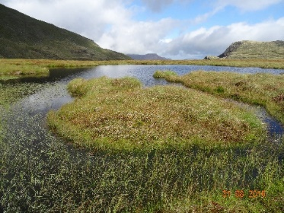
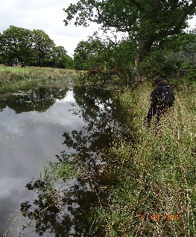
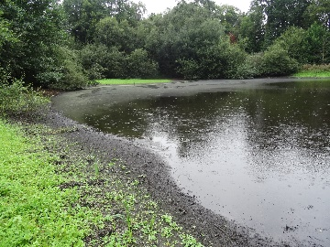
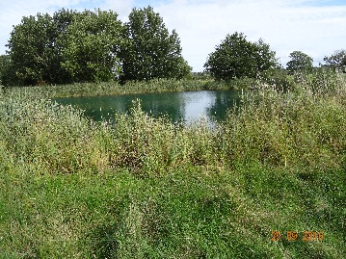
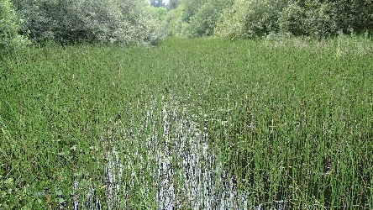
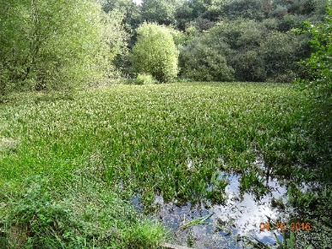
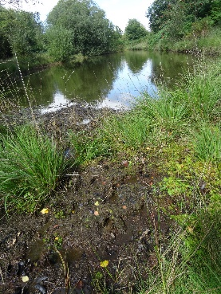
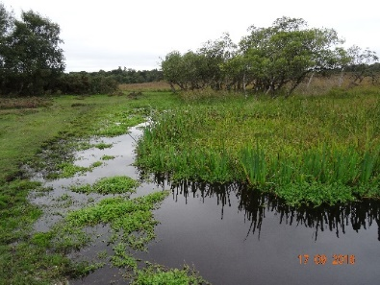
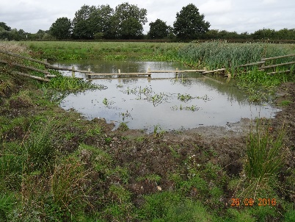
The survey sites
…were very varied: from upland tarns to lowland field ponds. Small and large ponds, shaded and open, deep/ permanent and shallow/semi-permanent

Slide 6
Results: Plant richness
England
Two-thirds (66%) of these high quality ponds lost plant species during the 24 year gap (in southern England this figure rose to 71% of sites).
On average the number of wetland plant species in each pond in England declined significantly by 17% from 25 to 21 species (p<0.001).
Of these, the number of submerged plants (the most sensitive group of species) dropped by almost a third (31%) (p<0.001).
Number of species
1991-93
2015-16

Slide 7
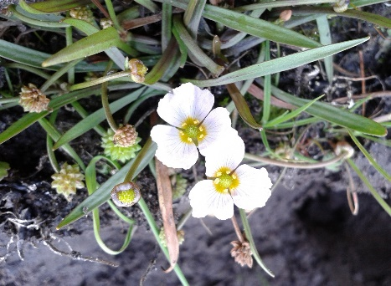
Results: Rare plants
Rare plants (Red Listed and Near Threatened) were harder hit than more common and widespread species
Proportion of common plant species lost
Proportion of rare plant species lost
England
- Over half (55%) of the ponds that had red listed plants in the1990s had lost one or more by 2016.
18% lost 3 or 4 red listed species
- This was a statistically significant loss (p<0.05)

Slide 8
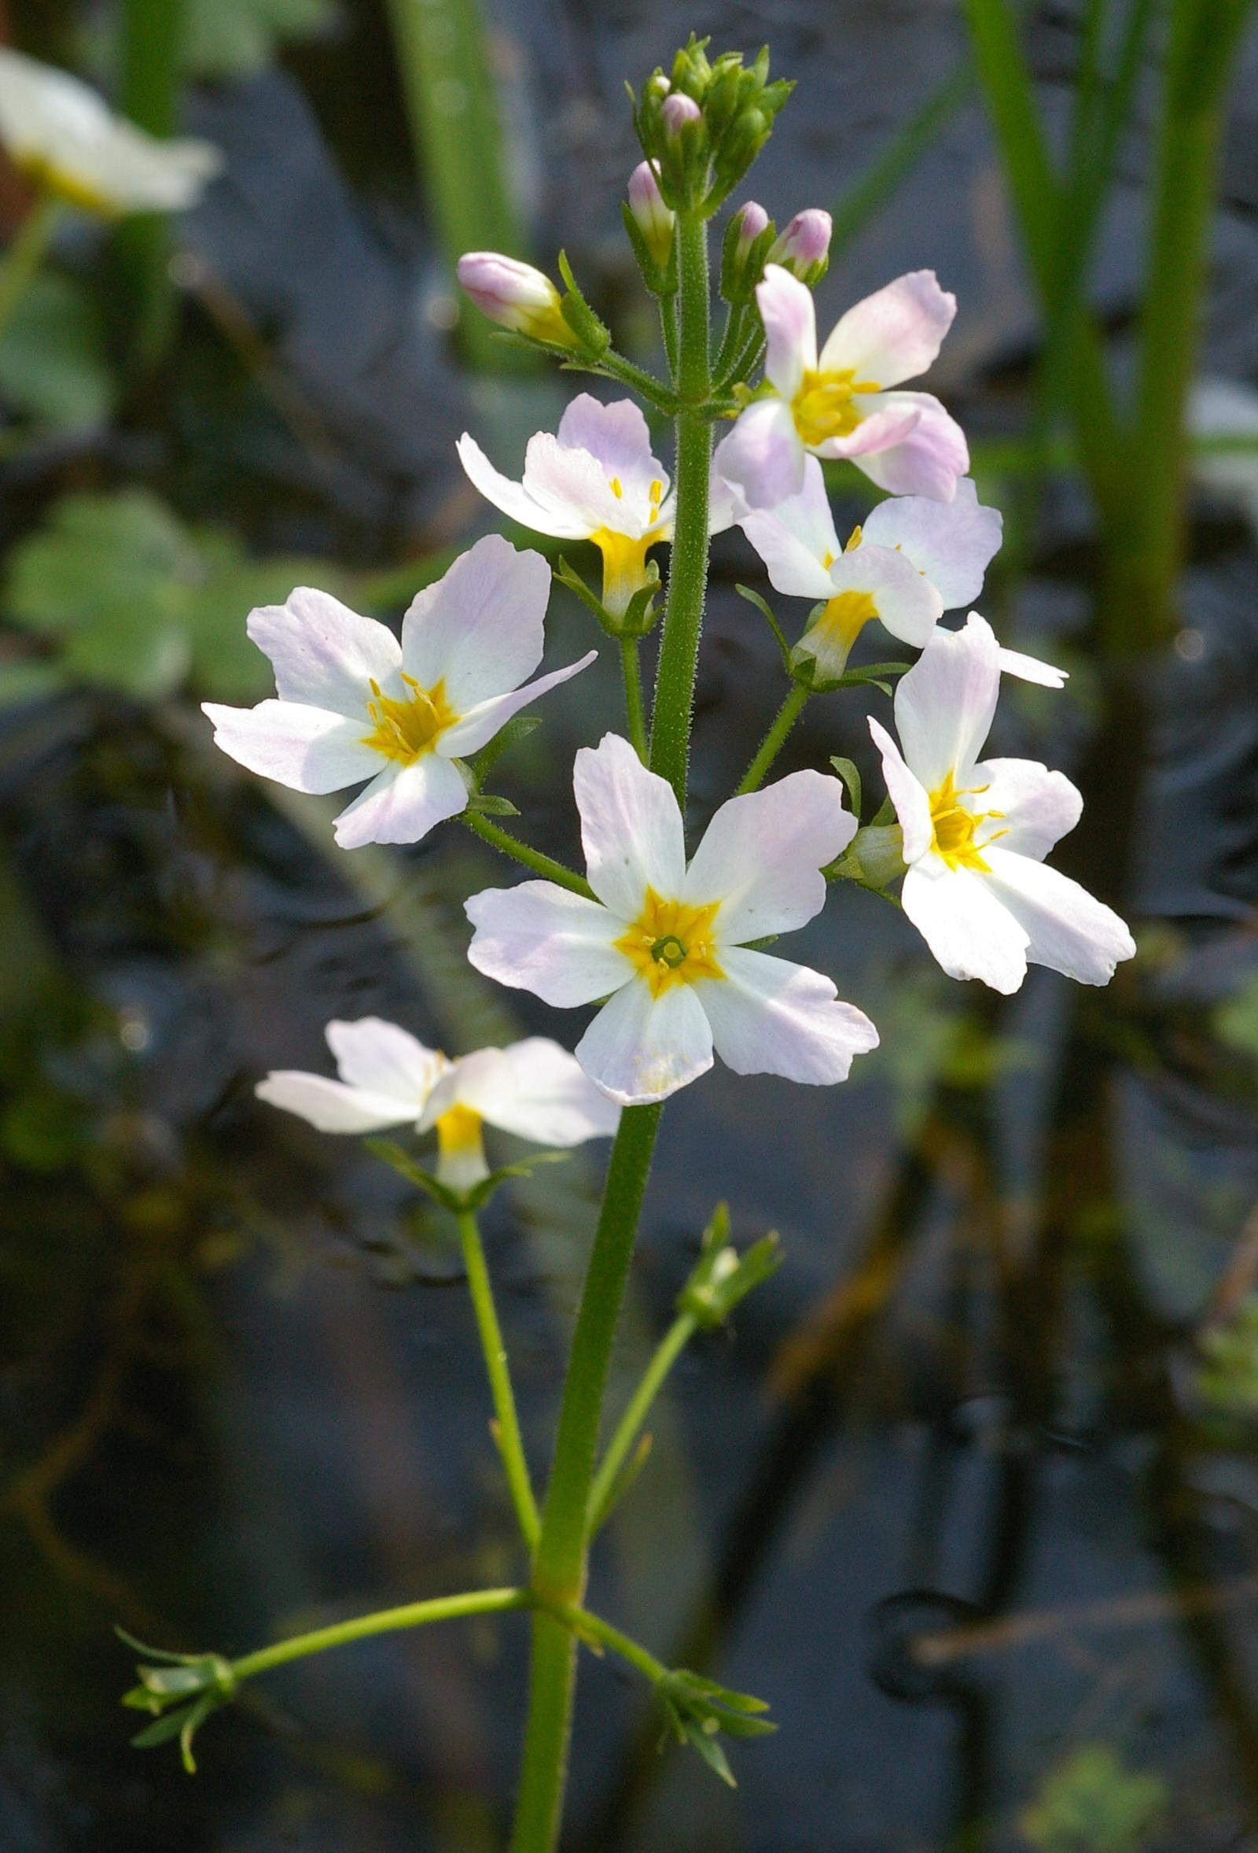
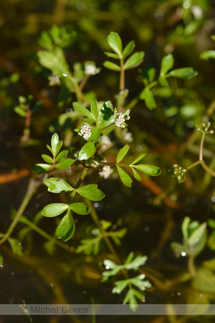
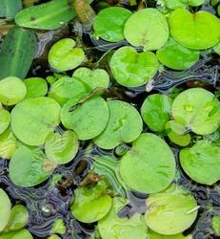
Results: Rare plants
England
In the 1990s well over 3/4 of high quality ponds had rare plant species compared with only 2/3 today
Ponds in the 1990s
Ponds today
…. and not only did many ponds lose their most uncommon species, but those still present were often just hanging on at very low abundance, and likely to be lost in the near future. For example…..
Water-violet Lost from a quarter of its sites, and almost gone from two others
Lesser marshwort Lost from over a third of its sites, and almost gone from another two-thirds
Frogbit
Lost from two of its four sites, and almost gone from one other

Slide 9
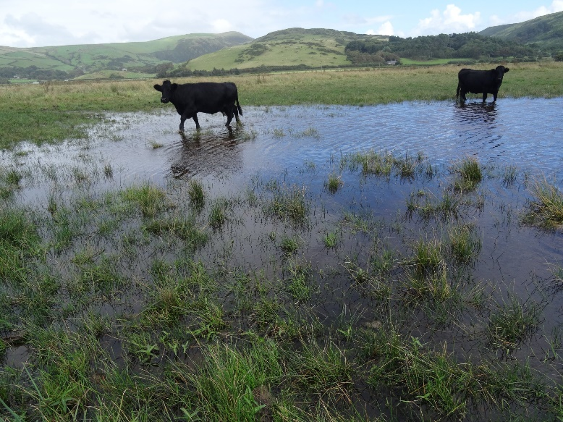
Results: Wales
Number of species
Welsh ponds largely retained their plant richness (though note there were only 11 sites). However there was a slight decline in the number of submerged species (6%) which are generally the most sensitive group of plants
Rare species
Wales does not have its own red list but, based on the Welsh S42 species list, the loss rate was similar to England: 50% of sites with an S42 species lost at least one by 2016. (NB There were too few Welsh sites with S42 species to test statistical significance levels).

Slide 10
Results: plant relationships
Perhaps not surprising but…..
There were strong trend relationships between all of the different plant groups
For example:
if marginal plants were lost, so too were submerged and floating species
rare species loss was strongly correlated with loss of marginal, aquatic and floating species
Implication
Suggests that changes weren’t due to things like natural succession – where you might expect the marginal plants to get better and the submerged plants to be lost – they were generic changes that affected the whole pond.

Slide 11
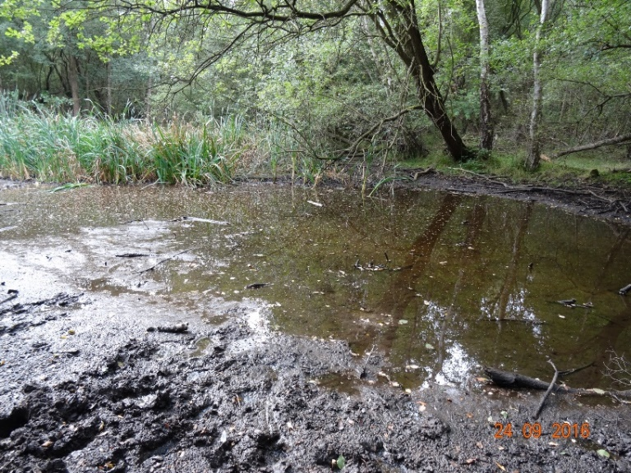
Explaining the loss (1)
In both surveys we collected environmental data; making it possible to look at the reasons for biodiversity loss……
Shade
Interestingly….
1990’s – there was no relationship
between tree shade and plant richness
Now – there’s a negative correlation
Between tree shade and plant richness
Increasing tree shade is related to
greater loss of plant species and
greater loss of uncommon plants
Implication: New growth of secondary scrub and woodland around ponds is significantly damaging the biodiversity of high quality ponds (supports our organisational view about the need to distinguish between new tree growth which is often damaging, and ponds in old woodland and on old hedge-lines, which can have important species and need care/survey before management)

Slide 12
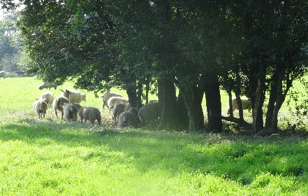
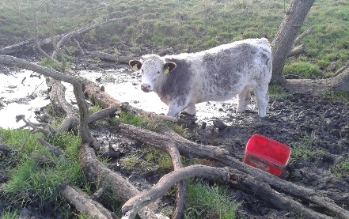
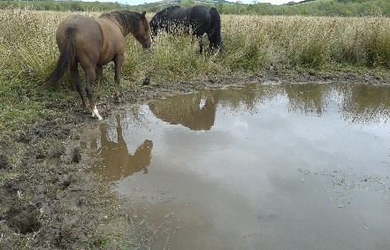
Explaining the loss (2)
Grazing
1990’s – no relationship seen between grazing and plant richness
Now – positive correlation between grazing and plant richness
Greater loss of plant species if ponds were not grazed (conversely, that ponds benefitted/were protected from plant loss, if they were grazed).
No evidence that any particular grazing regime was better: (i) by cattle/horses (sheep), (ii) if grazing was heavier/lighter, or (iii) if more/less of the pond was grazed.
– just that if ponds that were grazed in some way this maintained their richness better than ungrazed ponds.
In both surveys ponds were more likely to have rare species if they were grazed. No link between loss of grazing and change in rarity.
Implication
Grazing can maintain rare plants at ponds. Decline in grazing around ponds is likely damage their richness (linked to increased shade around ponds?) Supports our view about importance of grazing.

Slide 13
Explaining the loss (3)
Land use
Since these are all ponds located in semi-natural areas – you might assume that the surrounding landuse wouldn’t have much effect on pond quality – but in fact that’s not right…..
Larger reserves were better:
- Sites were more likely to retain plants and rare plants species if they were located in extensive semi natural areas e.g. in larger and more extensive nature reserves.
Ponds are better located within, rather than at the edge of, reserves
It was generally better for ponds to be located
in undisturbed areas deeper within reserves
rather than at their edge.
Conversely, ponds were more likely to loose
species and rare species if there was
intensive land use – particularly urban areas
(including roads) within 100m.
Pond richness declined more in the south than the north
- it’s probably safe to assume this is an effect of extinction debt: the area of high quality semi-natural wetlands, and hence sources of recolonising seeds and spores, is far lower in the south than the north.

Slide 14
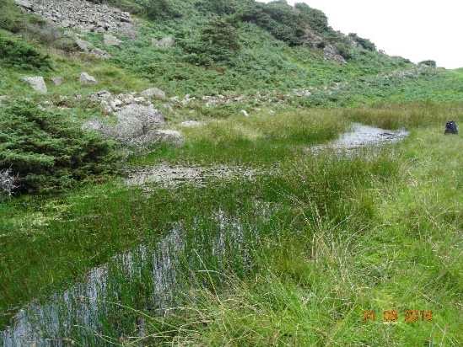
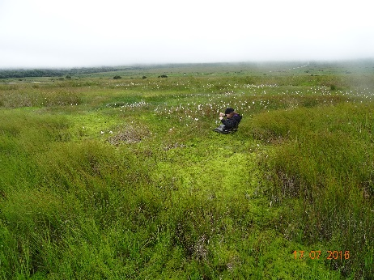
Explaining the loss (4)
Wetland land use
Ponds were less likely to lose marginal and submerged species if they are located in an area with substantial numbers of waterbodies and/or wetland areas nearby.
Decline in the proportion of waterbodies and wetlands within 100m of ponds was also correlated with greater loss of red-listed species.
Implication
This is evidence of the protective effect of semi-natural land-use and nearby waterbodies and wetlands and the negative impact of intensification around nature reserves.
It underlines the critical importance of nature reserves, semi-natural landscapes and waterbody and wetland networks for protecting high quality ponds and their freshwater biodiversity.

Slide 15
Explaining the loss (5)
A few other things……
Nutrients
There was a generally negative relationship between Ellenberg N and change in plant richness and rarity – so some indication that plant communities were more likely to decline in nutrient rich ponds
Plant cover
Ponds with high and increasing cover of free-floating plants (e.g. duckweed) correlated with a decline in submerged plant cover (no surprise….)
Ponds with a higher % cover of emergent plants were generally better protected against decline of emergent richness (supports our standard view about need for informed pond management when removing plants from overgrown ponds).
Alien plants
Increase in the number and cover of alien plants was associated with fewer submerged plant species. This could be a causative effect, or an artefact because alien plants are recorded closer to urban areas.

Slide 16
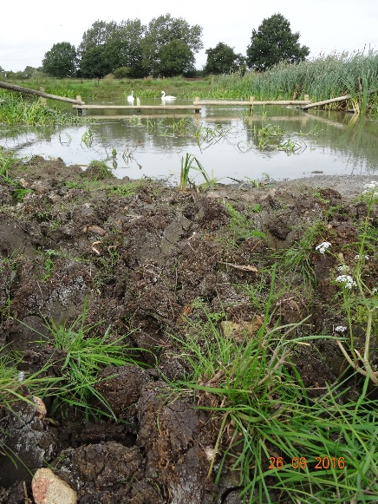
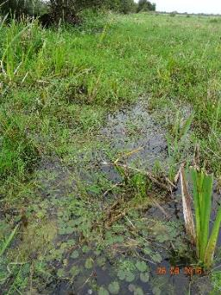
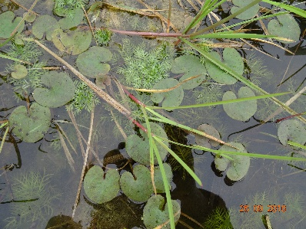
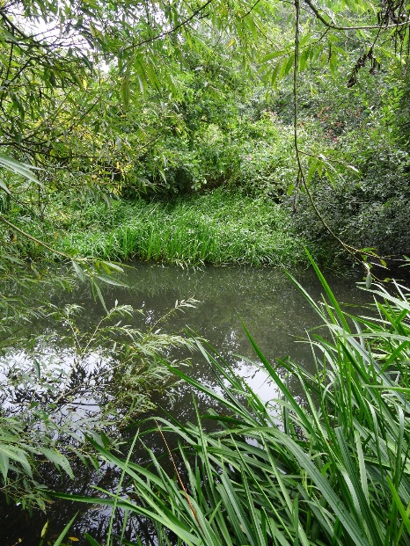
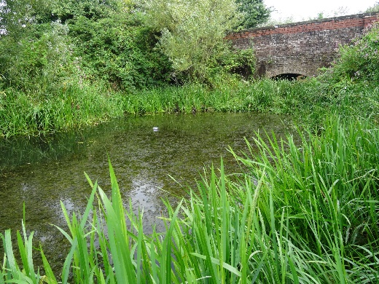
A couple of examples….
Otmoor (Oxfordshire) = good
Two ponds in an extensive, grazed, semi-natural area that has increased in wetness since the 1990s (higher water-levels, new ponds).
Survey ponds were richer and retained or increased their number of rarities.
Over (Gloucester) = bad
Two ponds near to urban areas, now fenced and increasingly shaded.
Pond richness massively declined, rarities lost and more - like the single remaining frog-bit plant – are on the brink

Slide 17
Conclusions
Worrying evidence that freshwater plant diversity is declining in our highest quality ponds in semi-natural landscapes and on reserves
Both the number of species, and number of rare species is declining
This is important because these ponds are biodiversity hotspots that support rich communities a high numbers of rare species
Declines are partly linked to declines in stock grazing and to greater shade from scrub growing up around ponds
Ponds fared better if protected within large, wet, semi-natural places
Answers
- Maintain (re-introduce) semi-natural grazing around ponds
Remove/control dense shade to stop new tree and scrub growing up around ponds (some exceptions – so still worth risk-assessing sites e.g. a botanical survey prior to management)
Wet-up areas to maintain the area and connectivity of wet bits (pond creation, raised groundwater levels if appropriate)
Increase area of semi-natural buffer around even nature-reserve ponds
- Regular monitoring so that losses can be prevented not observed

Slide 18
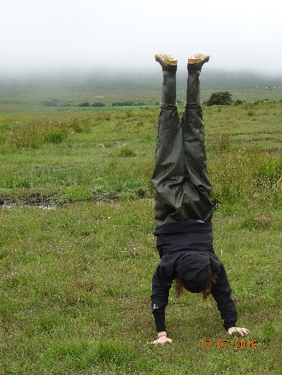

Slide 19
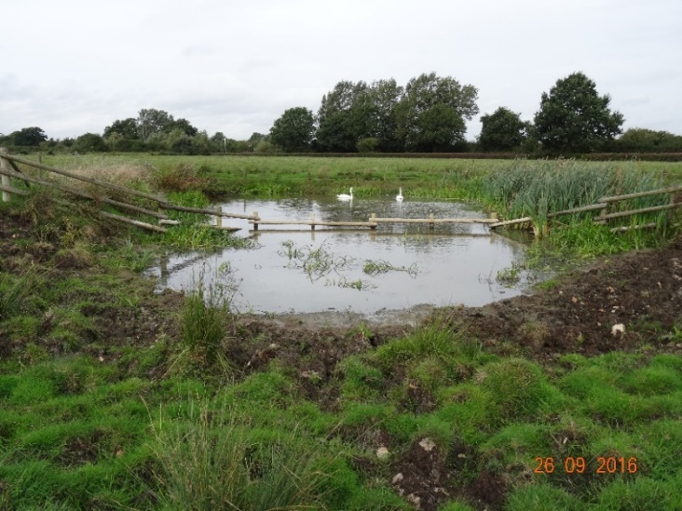
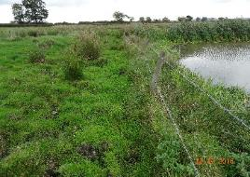
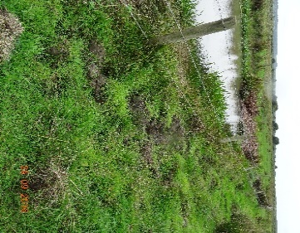
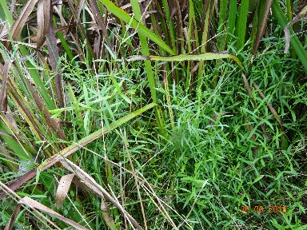
Strategic fencing: extra stuff you learn doing surveys...
Case example of strategic fencing.
Otmoor: Central Pond
Typical ‘conservation’ fencing – all or nothing
Never grazed
so mostly rank veg & tall emergents
Poached
to death
Strategic fencing: better
Winter – all edges outside the fence (brown areas) are wet and heavily poached by stock creating open muddy substrates (reduces competition so rarer plants can grow later in the year)
Summer – some pond edges are now dry and have no access to water for stock (lime green area): the bare edges here are minimally poached, which now allows uncommon plants to grow, flower and fruit.
Uncommon plants also grow where stock can easily reach over the fence close to the water’s edge (intermediate disturbance)
Tubular water-dropwort in areas that are wet and poached in winter but dry & little poached in summer
Heavy poaching all year because stock always have access to water. OK diversity of plants – but nothing special
Marsh stitchwort in a typical location – just over the fence
Tubular water-dropwort

